Slide 1



Comparative Analysis of Footballers
N060 - Yash Dukhande

Slide 2

TABLE OF CONTENTS
01
02
03
Domain Theory
Data Description
Problem Statement
04
06
07
Data Cleaning
Data Analysis
Conclusion

Slide 3

DOMAIN THEORY
STATISTICAL ANALYSIS
Systematic process of collecting, cleaning, organizing, interpreting, and drawing meaningful insights from data.
Use of statistical techniques, methods, and tools to summarize and analyze data, identify patterns and trends, make inferences, and draw conclusions.
Goal is to extract useful information from data to inform decision-making, solve problems, and gain a deeper understanding of a phenomenon.
Used in Business and Economics, Healthcare and Medicine, Environmental Science, Engineering, etc.

Slide 4
Types of Data
Types of Statistics
Descriptive Statistics: These methods help us summarize and describe data, e.g., mean, median, mode, standard deviation.
Data Visualization: It involves representing data graphically, e.g., histogram, scatter plot, pie-chart.
Qualitative (Categorical): Categories or labels, e.g., gender, color, or product type.
Quantitative (Numerical): Measurable values, e.g., age, income, or temperature.

Slide 5

Data Set about Football Player’s details from the FIFA game made by EA Sports
Data Description
Contains about 18000 rows (players) and 92 rows (different attributes)
Contains Details about Footballers like name, age, player value, wages, position, team, various ratings, traits, etc.
Dataset Link: https://data.world/raghav333/fifa-players

Slide 6
A statistical measure of the relationship between two variables. Measure of how much one variable changes in relation to another variable. Correlation can be positive, negative, or zero.
r is a measure of the linear correlation of two variables. It is a number that ranges from -1 to 0 to +1, representing the strength of the relationship between the variables.
Correlation
Two main types of correlation
i) Karl Pearson Correlation
ii) Spearman’s Rank Correlation

Slide 7

Problem Statement
Perform a comprehensive analysis of FIFA player data to gain deep insights into player performance, attribute rankings, and the factors influencing player success. This analysis will hope to provide a holistic understanding of the football players ecosystem and answer critical questions for fans, clubs, and enthusiasts.

Slide 8

DATA CLEANING

Slide 9
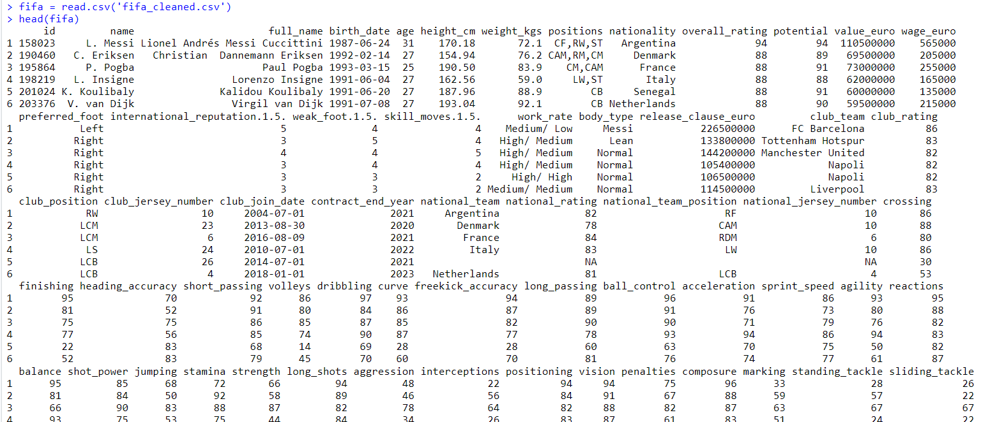
Reading the CSV File
Code:
fifa = read.csv('fifa_cleaned.csv')
head(fifa)

Slide 10
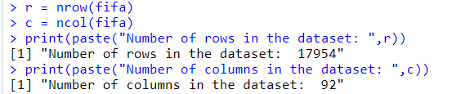
Details about rows and columns
Code:
r = nrow(fifa)
c = ncol(fifa)
print(paste("Number of rows in the dataset: ",r))
print(paste("Number of columns in the dataset: ",c))
attribute = colnames(fifa)
print("Column Names of the data set are:")
attribute

Slide 11
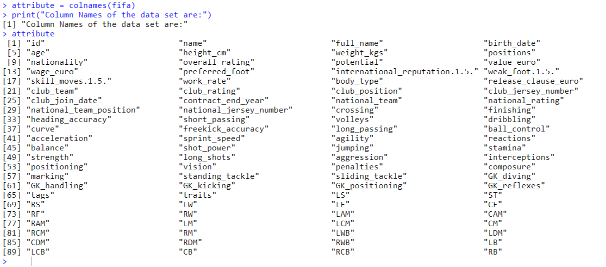

Slide 12
Filter out columns we do not need
Code:
c1 = c('name','age','nationality','positions','overall_rating','value_euro','wage_euro',
'club_team','crossing','finishing','heading_accuracy', 'short_passing', 'volleys',
'dribbling','curve','freekick_accuracy', 'long_passing', 'ball_control', 'acceleration',
'sprint_speed', 'agility', 'reactions', 'balance', 'shot_power', 'jumping', 'stamina',
'strength', 'long_shots', 'aggression', 'interceptions', 'positioning', 'vision',
'penalties', 'composure', 'marking', 'standing_tackle', 'sliding_tackle', 'GK_diving',
'GK_handling', 'GK_kicking', 'GK_positioning', 'GK_reflexes')
fifa = fifa[,c1]

Slide 13
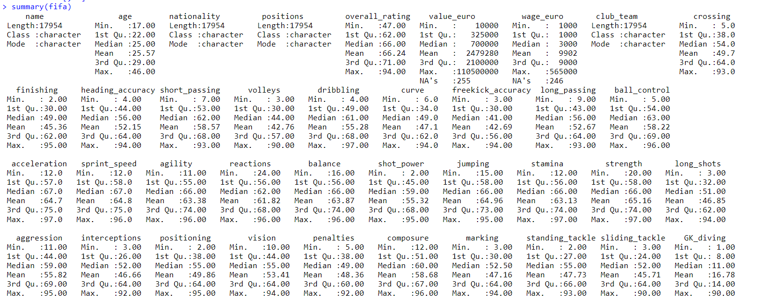

To get summary of dataset
Code: summary(fifa)

Slide 14
To remove NA Values and Filter out the rows
Code:
fifa = na.omit(fifa)
fifa = subset(fifa, overall_rating >= 75)

Slide 15
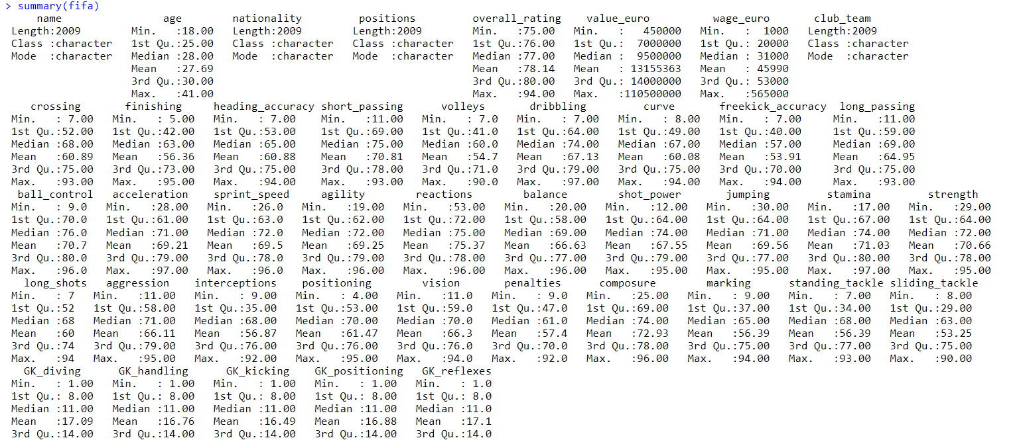
Final Summary of Cleaned Data
Code: summary(fifa)

Slide 16


DATA ANALYSIS

Slide 17
Head to Head Analysis of Players
Code:
attacking = c('finishing','heading_accuracy','freekick_accuracy','shot_power','penalties')
a = c('Finish','','Head','','Freekick','','Shot Pow','','Pen','')
playmaking = c('crossing','short_passing','dribbling','long_passing','vision')
p = c('Cross','','Short Pass','','Drib','','Long Pass','','Vision','')
physicality = c('sprint_speed','reactions','jumping','stamina','strength')
p1 = c('Speed','','React','','Jump','','Stamina','','Strength','')
defending = c('interceptions', 'positioning','marking', 'standing_tackle', 'sliding_tackle')
d = c('Intercept','', 'Position','', 'Mark','', 'Stand Tackle','', 'Slide Tackle','')
goalkeeping = c('GK_diving','GK_handling', 'GK_kicking', 'GK_positioning', 'GK_reflexes')
g = c('Dive','', 'Handle','', 'Kick','', 'Position','', 'Reflex','')

Slide 18
Head to Head Analysis of Players
random_names = sample(fifa$name, size = 2)
n1 = random_names[1]
n2 = random_names[2]
r1 = which(fifa$name == n1)
r2 = which(fifa$name == n2)
name1 = fifa$name[r1]
age1 = fifa$age[r1]
nationality1 = fifa$nationality[r1]
position1 = fifa$positions[r1]
rating1 = fifa$overall_rating[r1]
value1 = fifa$value_euro[r1]
attacking1 = unlist(fifa[r1,attacking])
playmaking1 = unlist(fifa[r1,playmaking])
physicality1 = unlist(fifa[r1,physicality])
defending1 = unlist(fifa[r1,defending])
goalkeeping1 = unlist(fifa[r1,goalkeeping])

Slide 19
Head to Head Analysis of Players
name2 = fifa$name[r2]
age2 = fifa$age[r2]
nationality2 = fifa$nationality[r2]
position2 = fifa$positions[r2]
rating2 = fifa$overall_rating[r2]
value2 = fifa$value_euro[r2]
attacking2 = unlist(fifa[r2, attacking])
playmaking2 = unlist(fifa[r2, playmaking])
physicality2 = unlist(fifa[r2, physicality])
defending2 = unlist(fifa[r2, defending])
goalkeeping2 = unlist(fifa[r2, goalkeeping])
print(paste(name1,' vs ', name2, ' Comparison'))
print(paste('Age: ', age1, ' | ', age2))
print(paste('Nationality: ', nationality1, ' | ', nationality2))
print(paste('Position: ', position1, ' | ', position2))
print(paste('Rating: ', rating1, ' | ', rating2))
print(paste('Value(Euros): ', value1, ' | ', value2))

Slide 20
Head to Head Analysis of Players
barplot(c(attacking1,attacking2),col = c('red','blue'),width = 2,names.arg = a, main = paste(name1,' vs ', name2, ' Attacking stats'))
legend("topright", legend = c(name1,name2), fill = c('red','blue'))
barplot(c(playmaking1,playmaking2),col = c('red','blue'),width = 2,names.arg = p, main = paste(name1,' vs ', name2, ' Playmaking stats'))
legend("topright", legend = c(name1,name2), fill = c('red','blue'))
barplot(c(physicality1,physicality2),col = c('red','blue'),width = 2,names.arg = p1, main = paste(name1,' vs ', name2, ' Physicality stats'))
legend("topright", legend = c(name1,name2), fill = c('red','blue'))
barplot(c(defending1,defending2),col = c('red','blue'),width = 2,names.arg = d, main = paste(name1,' vs ', name2, ' Defending stats'))
legend("topright", legend = c(name1,name2), fill = c('red','blue'))
barplot(c(goalkeeping1,goalkeeping2),col = c('red','blue'),width = 2,names.arg = g, main = paste(name1,' vs ', name2, ' Goalkeeping stats'))
legend("topright", legend = c(name1,name2), fill = c('red','blue'))

Slide 21
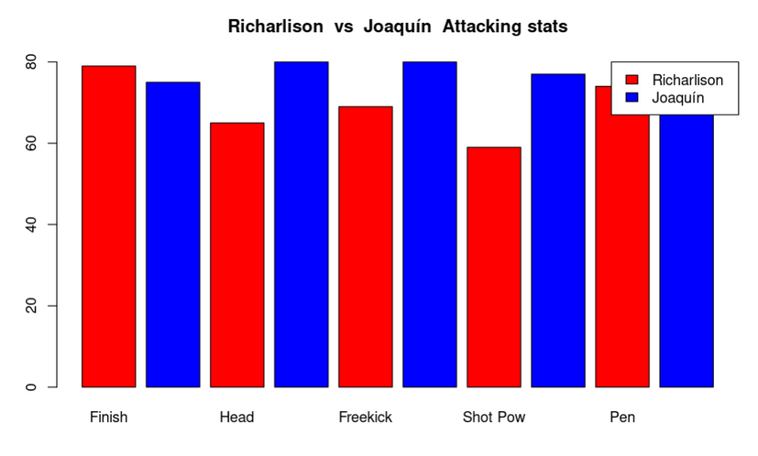
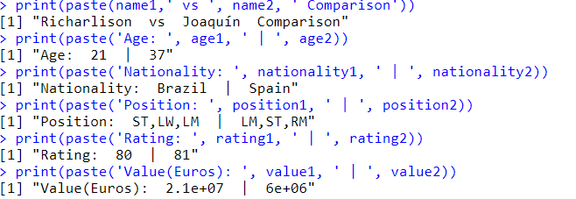
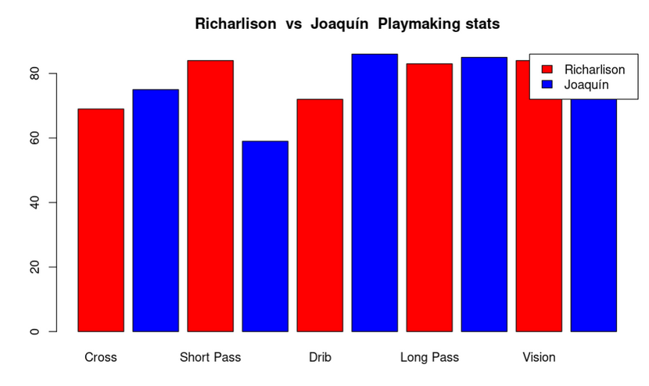
Screen Shots of the Code

Slide 22
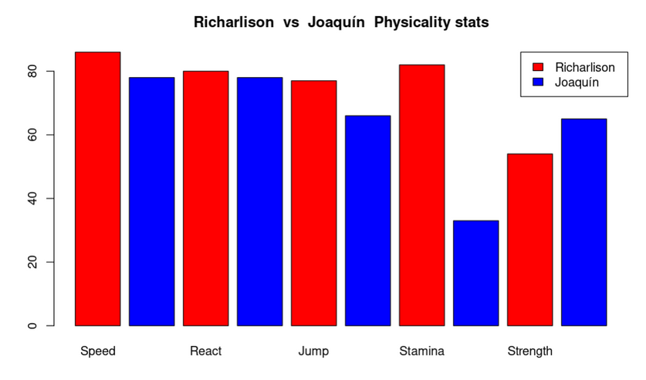
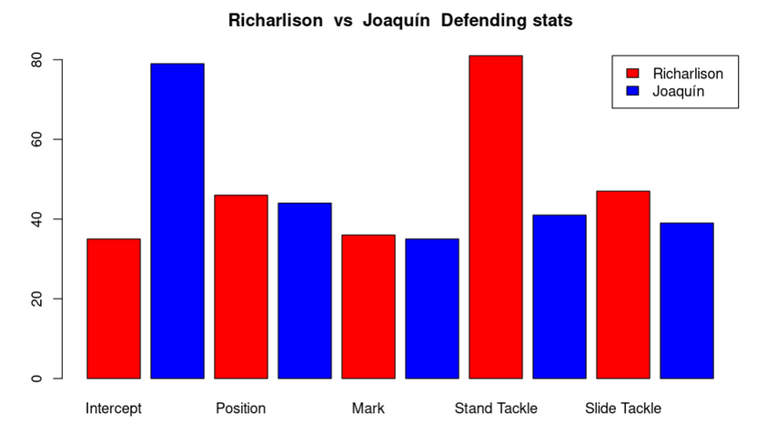
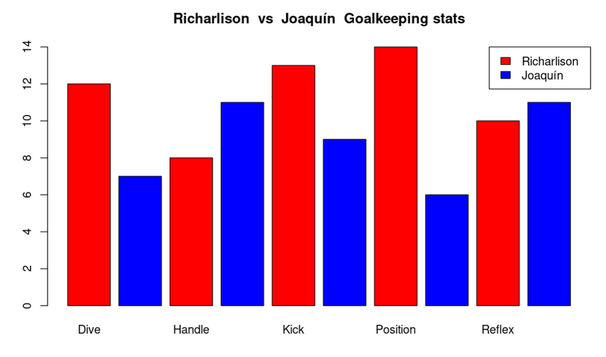
Screen Shots of the Code

Slide 23
Correlation Analysis
Code:
corelation = function(z){
if(z==0){
print('No relation')
}else if(z<0){
print('Negative corelation')
}else{
print("Positive corelation")
}
z = abs(z)
if(z == 1){
print("Perfect Relation")
}else if(z>0.7){
print("Strong Relation")
}else if(z>0.3){
print("Moderate Relation")
}else{
print("Weak Relation")
}
}

Slide 24
Correlation Analysis
fifa$attacking = (fifa$finishing + fifa$heading_accuracy + fifa$freekick_accuracy + fifa$shot_power + fifa$penalties)/5
fifa$playmaking = (fifa$crossing + fifa$short_passing + fifa$dribbling + fifa$long_passing + fifa$vision)/5
fifa$physicality = (fifa$sprint_speed + fifa$reactions + fifa$jumping + fifa$stamina + fifa$strength)/5
fifa$defending = (fifa$interceptions + fifa$positioning + fifa$marking + fifa$standing_tackle + fifa$sliding_tackle)/5
fifa$goalkeeping = (fifa$GK_diving + fifa$GK_handling + fifa$GK_kicking + fifa$GK_positioning + fifa$GK_reflexes)/5
pairs(fifa[,c('age','value_euro','overall_rating')])
x = cor(fifa$age,fifa$value_euro)
print(paste('Age and Value Corelation is: ',x))
corelation(x)
x = cor(fifa$age,fifa$overall_rating)
print(paste('Age and Rating Corelation is: ',x))
corelation(x)
x = cor(fifa$value_euro,fifa$value_euro)
print(paste('Rating and Value Corelation is: ',x))
corelation(x)

Slide 25
Correlation Analysis
plot(fifa$attacking,fifa$overall_rating)
x = cor(fifa$attacking,fifa$overall_rating)
print(paste('Attacking and Rating Corelation is: ',x))
corelation(x)
plot(fifa$playmaking,fifa$overall_rating)
x = cor(fifa$playmaking,fifa$overall_rating)
print(paste('Playmaking and Rating Corelation is: ',x))
corelation(x)
plot(fifa$physicality,fifa$overall_rating)
x = cor(fifa$physicality,fifa$overall_rating)
print(paste('Physicality and Rating Corelation is: ',x))
corelation(x)
plot(fifa$defending,fifa$overall_rating)
x = cor(fifa$defending,fifa$overall_rating)
print(paste('Defending and Rating Corelation is: ',x))
corelation(x)
plot(fifa$goalkeeping,fifa$overall_rating)
x = cor(fifa$goalkeeping,fifa$overall_rating)
print(paste('Goalkeeping and Rating Corelation is: ',x))
corelation(x)

Slide 26
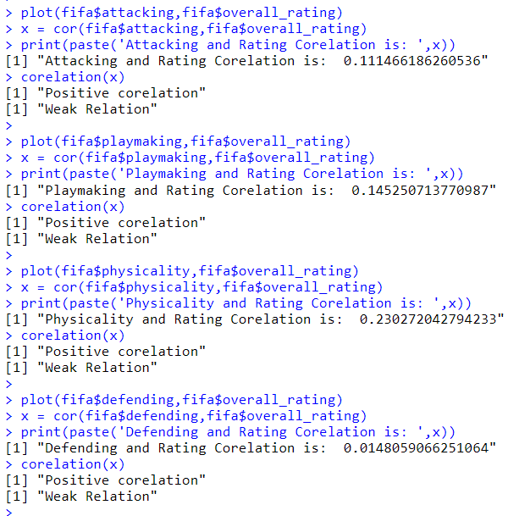
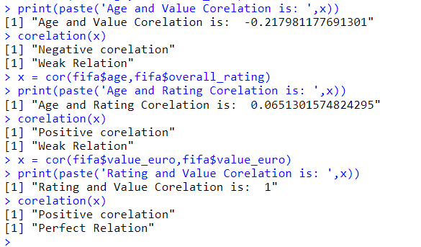
Screen Shots

Slide 27
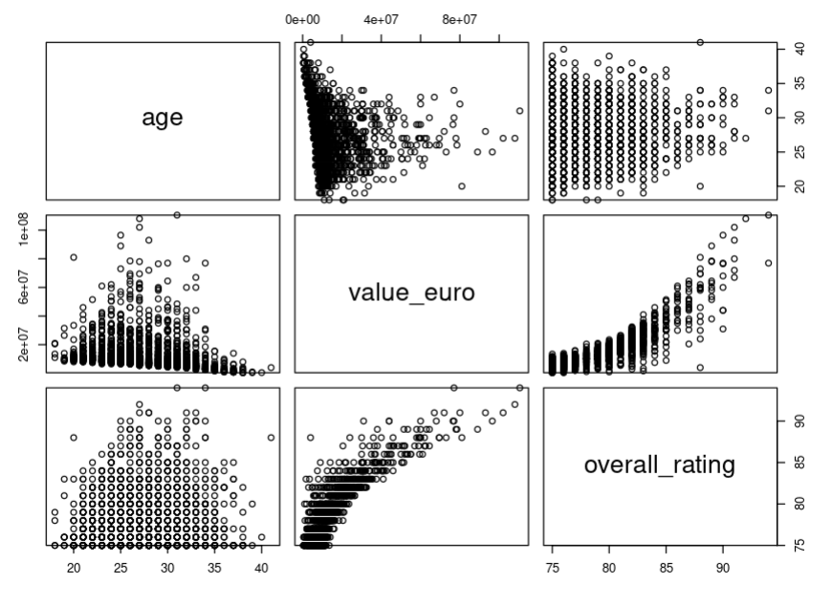
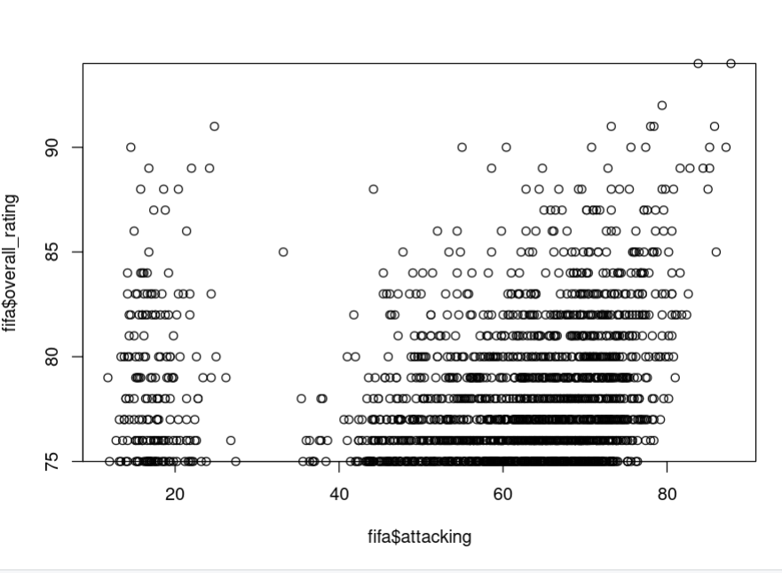
Screen Shots

Slide 28
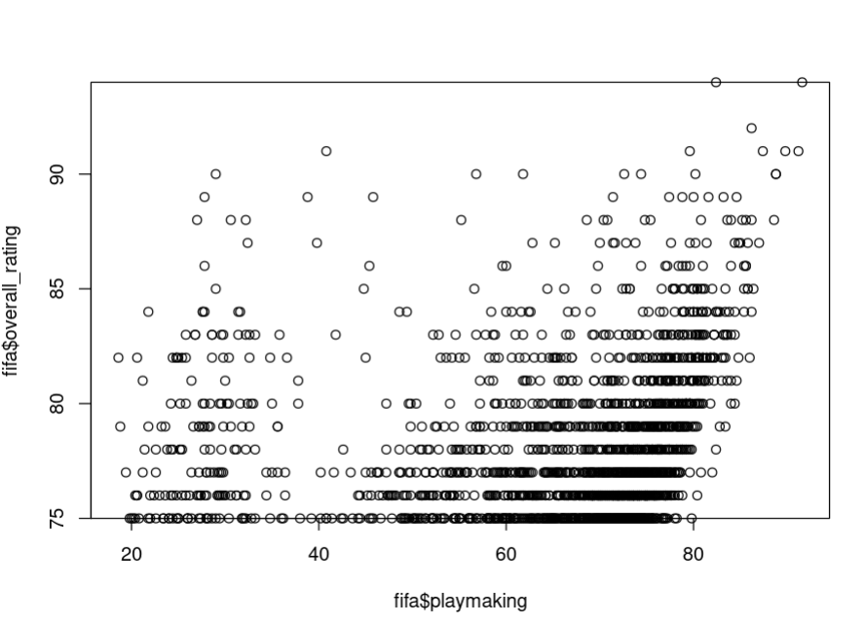
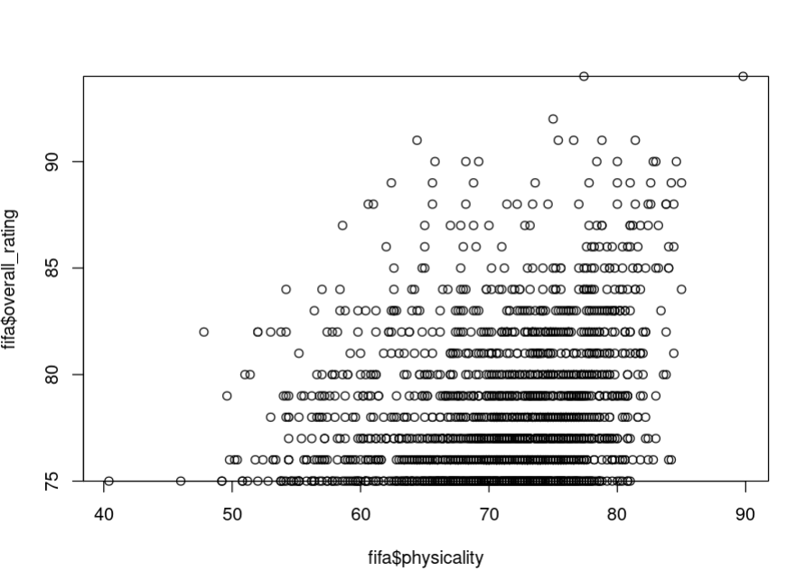
Screen Shots

Slide 29
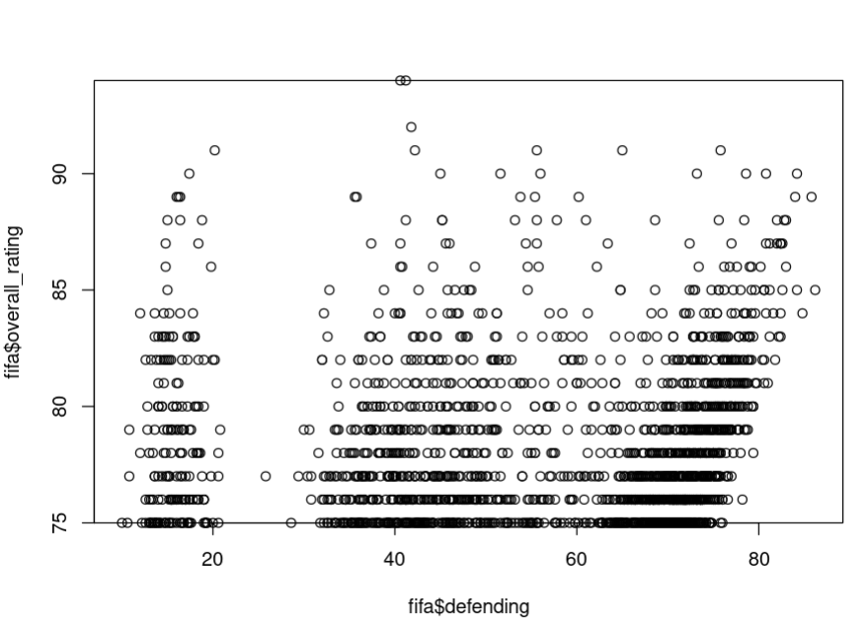
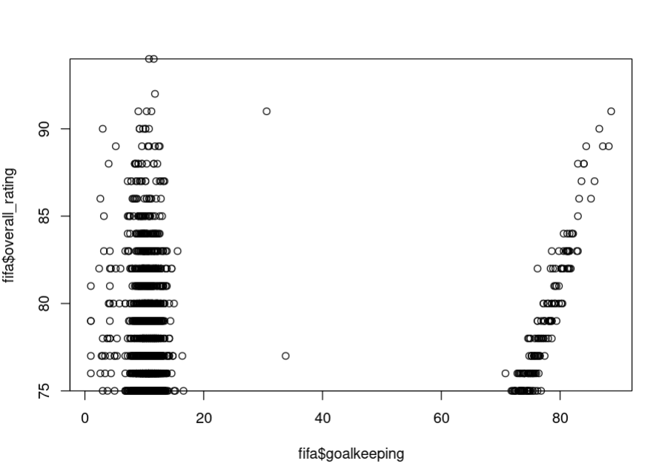
Screen Shots

Slide 30



CONCLUSION
We have successfully implemented Data Cleaning and Analysis.
This data analysis used by scouting, clubs, managing team and award organizations to name a few.

